Slide 1
SupportPilot – AI Ticket Resolution Agent

Slide 2
Introduction
SupportPilot – AI Ticket Resolution Agent, an AI-powered platform designed to automate IT support-ticket processing, troubleshooting, and resolution workflows.
Modern organizations receive a large number of IT support requests every day.
These requests may involve network connectivity, software installation, password resets, VPN access, hardware problems, and system troubleshooting.
Handling a large volume of repetitive tickets manually can increase operational costs, delay response times, and reduce employee productivity.

Slide 3
SupportPilot is proposed as an AI-powered Ticket Resolution Agent that automates important stages of the IT support process.
The system can analyze incoming support tickets, classify the problem, retrieve relevant troubleshooting information, generate contextual solutions, and escalate unresolved problems to human support staff.
The project combines technologies such as Large Language Models (LLMs), Retrieval-Augmented Generation (RAG), multi-agent AI architectures, and enterprise integrations.
The intended result is a more efficient support system that reduces ticket resolution time and improves employee satisfaction.

Slide 4
Main Objective
The main objective is:
To develop an intelligent AI-based support system that can receive, understand, classify, troubleshoot, resolve, and appropriately escalate IT support tickets.

Slide 5
Modules
Module 1 – Ticket Intake & Classification
Module 2 – Knowledge Retrieval Engine
Module 3 – AI Resolution Generator
Module 4 – Multi-Agent Resolution Framework
Module 5 – Escalation & Workflow Management
Module 6 – Dashboard & Analytics

Slide 6
Milestone 1 – Ticket Processing & Classification
According to the uploaded SupportPilot – AI Ticket Resolution Agent document, Milestone 1 covers Weeks 1–2 and has three main objectives:
Ticket submission and ingestion
AI-based ticket classification
Severity and priority score generation
The expected evaluation is ≥90% ticket classification accuracy and ≥85% severity prediction accuracy by Week 2

Slide 7
The main objective of Milestone 1 is to build the first working version of the SupportPilot system that can:
  Accept an IT support ticket.
  Store the ticket.
  Identify the type/category of the problem.
  Predict its severity.
  Assign a priority.
  Display the classification result.

Slide 8
Typical tickets mentioned in the project include:
  Network connectivity
  Software installation
  Password reset
  VPN access
  Hardware problems
  System troubleshooting

Slide 9
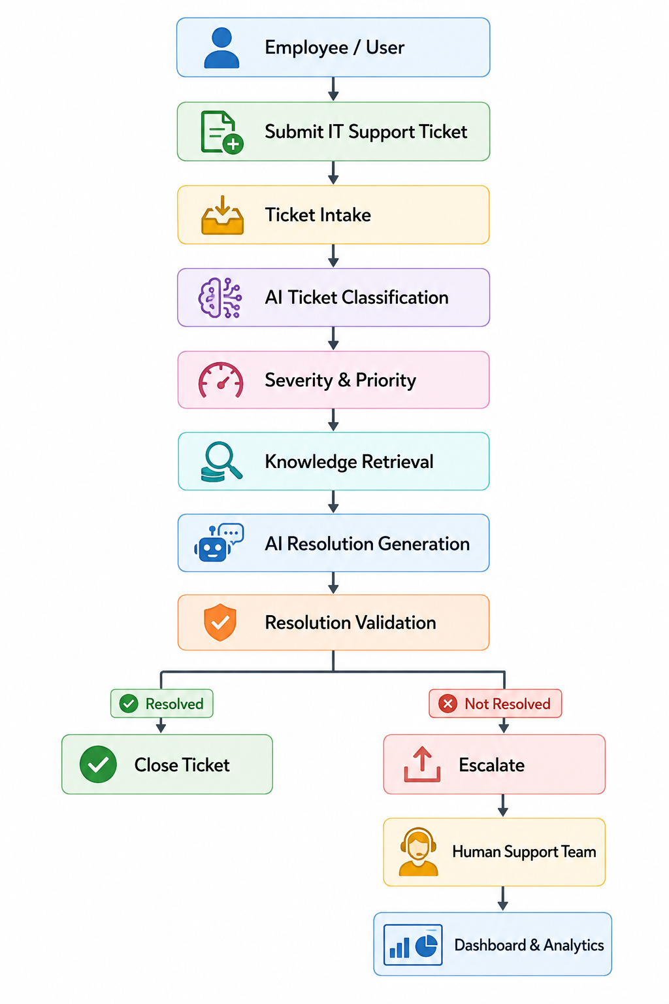
Milestone:1
Architecture

Slide 10
2. Technologies for Milestone 1
Component Technology
Programming Language Python
Backend Flask
Authentication Session Login
Machine Learning Scikit-learn
Text Processing TF-IDF
Classification Logistic Regression
Database SQLite
Frontend HTML + Bootstrap (White UI)
API Flask REST API

Slide 11
3. Folder Structure
Create the following project:
SupportPilot/
│
├── app.py # Flask backend + login
├── train_model.py
├── classifier.py
├── database.py # SQLite users + tickets
├── requirements.txt
│
├── models/
│ └── ticket_classifier.pkl
│
├── templates/
│ ├── login.html # White login page
│ └── index.html # White dashboard (no tabs)
│
├── static/
│ ├── style.css
│ └── logo.svg
│
└── tickets.db

Slide 12
4. Install Required Packages
Create requirements.txt:
Flask
scikit-learn
pandas
joblib
Install:
pip install Flask scikit-learn pandas joblib

Slide 13
For example:
Ticket:
"VPN is not connecting and I have an important client meeting in 30 minutes."
↓
Category: VPN Access
Severity: High
Priority: P1
Confidence: 94%

Slide 14
Work 1 – Ticket Submission
Work 1 – Ticket Submission
What is implemented?
  A simple web form can collect:
  Employee name
  Email
  Ticket title
  Ticket description
  Department

Slide 15
Example
Employee Name : Arun
Email : arun@company.com
Title:
VPN not working
Description:
I am unable to connect to the company VPN.
I have an important meeting with a client today.
The information is sent to the backend.

Slide 16
Work 2 – Ticket Ingestion
Ticket ingestion means receiving the support request and converting it into a standard format.
Example JSON:
{
"ticket_id": "T1001",
"employee": "Arun",
"title": "VPN not working",
"description": "Unable to connect to company VPN",
"department": "Sales"
}

Slide 17
This common format allows the AI system to process tickets regardless of whether they eventually arrive through:
  Web form
  Email
  Ticketing system
The project specification explicitly identifies these as ticket intake sources.

Slide 18
Work 3 – Text Pre-processing
Before classification, the ticket text can be cleaned.
Example
Original:
URGENT!!! My VPN is NOT connecting!!!
Please help me ASAP!!!
After preprocessing:
urgent vpn not connecting please help

Slide 19
Typical operations:
Lowercase
↓
Remove unnecessary symbols
↓
Tokenization
↓
Stop-word handling
↓
Feature extraction

Slide 20
6. Work 4 – AI Ticket Classification
This is the most important component of Milestone 1.
The AI model determines what type of problem the ticket represents.

Slide 21
Possible classes
Category Example
Network Wi-Fi not working
VPN VPN connection failure
Password Password reset
Software Application installation
Hardware Keyboard/monitor failure
System Operating system problem
The project requires automatic categorization based on the issue type and business impact.

Slide 22
7. Simple Python Implementation
For Milestone 1, a simple TF-IDF + Logistic Regression classifier is a good demonstration before moving to an LLM-based classifier.
Install
pip install pandas scikit-learn

Slide 23
Training data
imporimport pandas as pd
data = {
"ticket": [
"WiFi is not working",
"Internet connection is very slow",
"VPN is not connecting",
"Unable to access company VPN",
"I forgot my password",
"Please reset my password",
"Install Microsoft Office",
"Application installation required",
"Laptop keyboard is not working",
"Monitor display is not working"
],
"category": [
"Network",
"Network",
"VPN",
"VPN",
"Password",
"Password",
"Software",
"Software",
"Hardware",
"Hardware"
]
}
df = pd.DataFrame(data)
print(df)

Slide 24
8. Train the AI Classifier
from sklearn.model_selection import train_test_split
from sklearn.feature_extraction.text import TfidfVectorizer
from sklearn.linear_model import LogisticRegression
X = df["ticket"]
y = df["category"]
X_train, X_test, y_train, y_test = train_test_split(
X,
y,
test_size=0.2,
random_state=42
)
vectorizer = TfidfVectorizer()
X_train_vector = vectorizer.fit_transform(X_train)
X_test_vector = vectorizer.transform(X_test)
model = LogisticRegression()
model.fit(X_train_vector, y_train)
accuracy = model.score(X_test_vector, y_test)
print("Accuracy:", accuracy)

Slide 25
What happens here?
Ticket Text
↓
TF-IDF
↓
Numerical Features
↓
Logistic Regression
↓
Category

Slide 26
9. Predict a New Ticket
new_ticket = [
"I cannot connect to the company VPN"
]
new_ticket_vector = vectorizer.transform(new_ticket)
prediction = model.predict(new_ticket_vector)
print("Predicted Category:", prediction[0])

Slide 27
Expected output:
Predicted Category: VPN

Slide 28
10. Work 5 – Severity Prediction
Classification tells us what the problem is.
Severity tells us how serious the problem is.
For example:

Slide 29
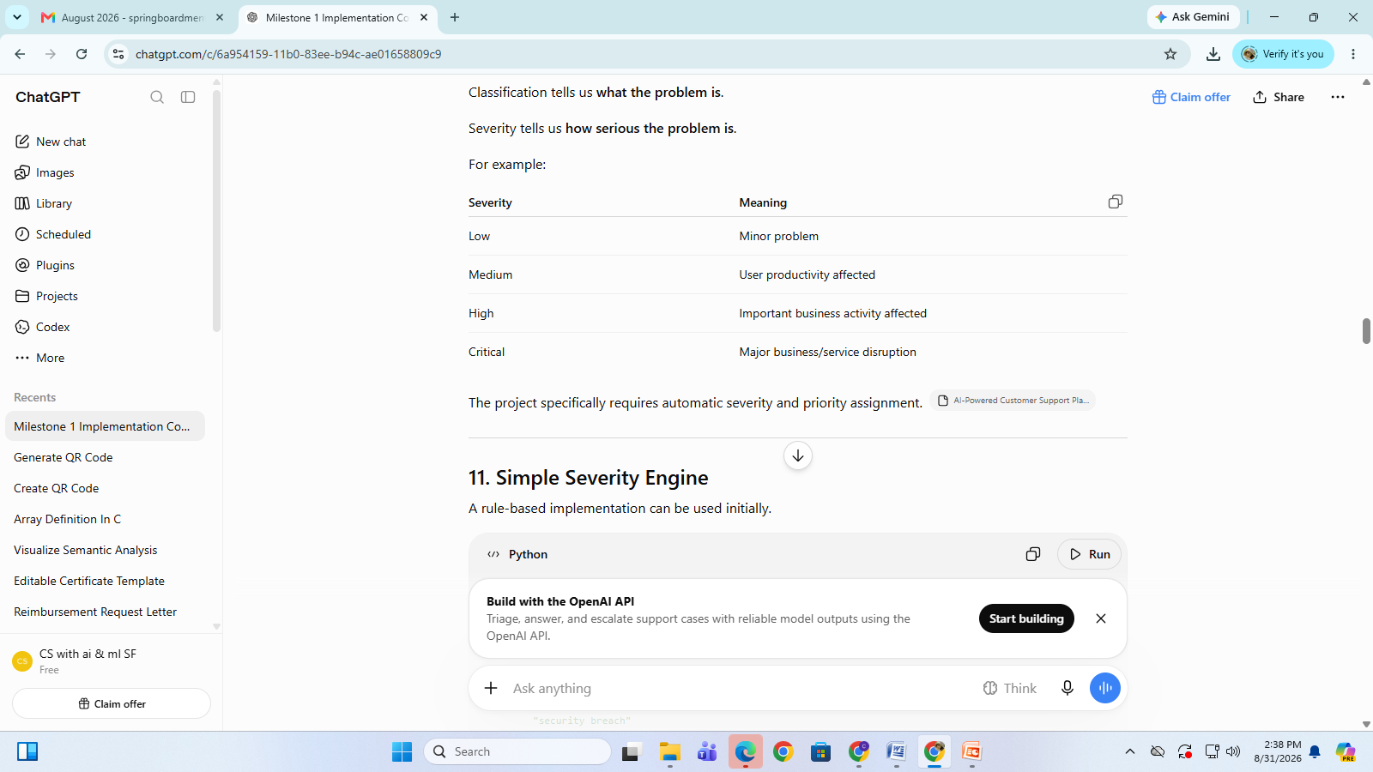

Slide 30
11. Simple Severity Engine
A rule-based implementation can be used initially.
def predict_severity(ticket):
text = ticket.lower()
critical_words = [
"server down",
"entire company",
"production down",
"security breach"
]
high_words = [
"urgent",
"cannot work",
"business stopped",
"client meeting",
"vpn not working"
]
medium_words = [
"slow",
"error",
"problem",
"issue"
]
for word in critical_words:
if word in text:
return "Critical"
for word in high_words:
if word in text:
return "High"
for word in medium_words:
if word in text:
return "Medium"
return "Low"

Slide 31
Test:
ticket = """
VPN is not working.
I have an important client meeting in 30 minutes.
"""
severity = predict_severity(ticket)
print("Severity:", severity)

Slide 32
Output:
Severity: High

Slide 33
12. Work 6 – Priority Calculation
Severity and priority are related but not identical.
For example:
Severity = High
Business Impact = High
should produce:
Priority = P1

Slide 34
A simple implementation:
def calculate_priority(severity, business_impact):
if severity == "Critical" and business_impact == "High":
return "P1"
elif severity == "High" and business_impact == "High":
return "P1"
elif severity == "High":
return "P2"
elif severity == "Medium":
return "P3"
else:
return "P4"

Slide 35
Example:
severity = "High"
business_impact = "High"
priority = calculate_priority(
severity,
business_impact
)
print("Priority:", priority)

Slide 36
Output:
Priority: P1

Slide 37
Complete Milestone 1 Demo
We can combine all three components.
def process_ticket(ticket):
# Classification
ticket_vector = vectorizer.transform([ticket])
category = model.predict(ticket_vector)[0]
# Severity
severity = predict_severity(ticket)
# Priority
if severity == "Critical":
priority = "P1"
elif severity == "High":
priority = "P2"
elif severity == "Medium":
priority = "P3"
else:
priority = "P4"
return category, severity, priority

Slide 38
ticket = """
URGENT: VPN is not connecting.
I cannot work and I have an important client meeting.
"""
category, severity, priority = process_ticket(ticket)
print("Ticket:", ticket)
print("Category:", category)
print("Severity:", severity)
print("Priority:", priority)

Slide 39
Possible output:
Ticket:
URGENT: VPN is not connecting.
I cannot work and I have an important client meeting.
Category: VPN
Severity: High
Priority: P2

Slide 40
14. Real-Time Comparison Example
A very useful demonstration for your project presentation is to compare traditional manual support with SupportPilot AI.
Scenario
An employee submits:
"I cannot connect to the VPN. I have a client presentation in 20 minutes.“

Slide 41
Traditional System
Employee
↓
Send Email
↓
Support Executive Opens Email
↓
Read Ticket
↓
Identify Category
↓
Determine Severity
↓
Assign Technician
↓
Technician Starts Investigation
Possible time:
10–30 minutes before proper assignment, depending on the support team's workload.

Slide 42
SupportPilot
Employee
↓
Ticket Submitted
↓
AI Classification
↓
VPN
↓
High Severity
↓
High Priority
↓
Automatic Routing
Potential processing:
Seconds rather than minutes for the automated intake/classification stage.
The exact time should be measured experimentally in your implementation rather than presented as a guaranteed project result.

Slide 43
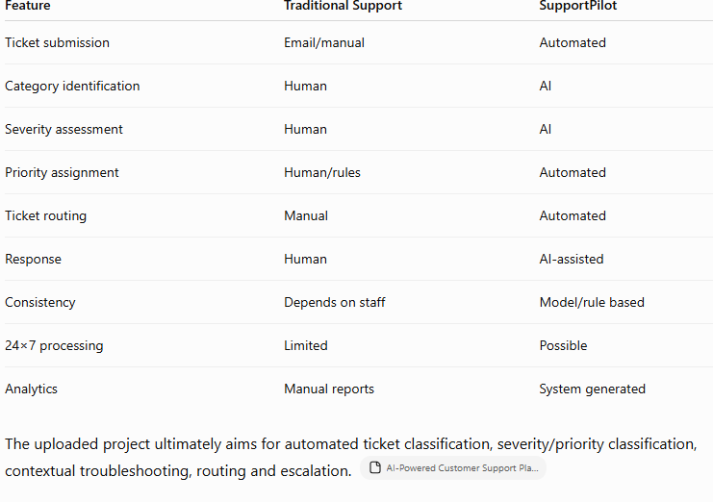
15. Real-Time Comparison Table

Slide 44
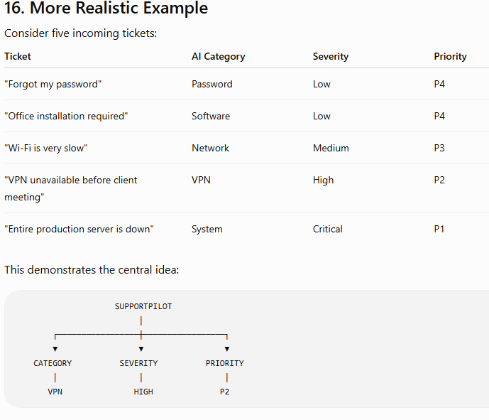

Slide 45
17. Suggested Database Table
For Milestone 1, create a tickets table.
CREATE TABLE tickets (
ticket_id INT PRIMARY KEY AUTO_INCREMENT,
employee_name VARCHAR(100),
email VARCHAR(150),
title VARCHAR(255),
description TEXT,
category VARCHAR(50),
severity VARCHAR(20),
priority VARCHAR(10),
confidence FLOAT,
status VARCHAR(30),
created_at TIMESTAMP DEFAULT CURRENT_TIMESTAMP
);

Slide 46
Example record:
1001 | Arun | arun@company.com |
VPN not working |
Unable to connect to VPN |
VPN | High | P2 | 0.94 | Open

Slide 47
18. Simple Flask Backend
You can demonstrate ticket ingestion through a REST API.
pip install flask

Slide 48
from flask import Flask, request, jsonify
app = Flask(__name__)
@app.route("/ticket", methods=["POST"])
def create_ticket():
data = request.json
ticket = data["description"]
category, severity, priority = process_ticket(ticket)
result = {
"ticket": ticket,
"category": category,
"severity": severity,
"priority": priority,
"status": "Open"
}
return jsonify(result)
if __name__ == "__main__":
app.run(debug=True)

Slide 49
A request can be:
{
"description": "VPN is not connecting and I cannot attend my client meeting“
}

Slide 50
Response:
{
"ticket":
"VPN is not connecting and I cannot attend my client meeting",
"category": "VPN",
"severity": "High",
"priority": "P2",
"status": "Open"
}

Slide 51
20. Evaluation
Your project document specifies these Milestone 1 targets:
Classification accuracy ≥ 90%
Severity prediction accuracy ≥ 85%
For the actual evaluation, prepare a test dataset such as:
100 support tickets

Slide 52
Then calculate:
Classification Accuracy = Correctly classified tickets -------------------------------- × 100 Total tickets
For example:
92 correctly classified ----------------------- × 100 100 total tickets = 92%

Slide 53
Therefore:
Target : ≥ 90%
Achieved : 92%
Status : PASS
For severity:
88 correctly predicted ---------------------- × 100
100 total tickets
= 88%
Target : ≥ 85%
Achieved : 88%
Status : PASS
Important: these 92%/88% figures are illustrative examples, not actual results from your project. Your final report should use the results obtained from your test dataset.

Slide 54
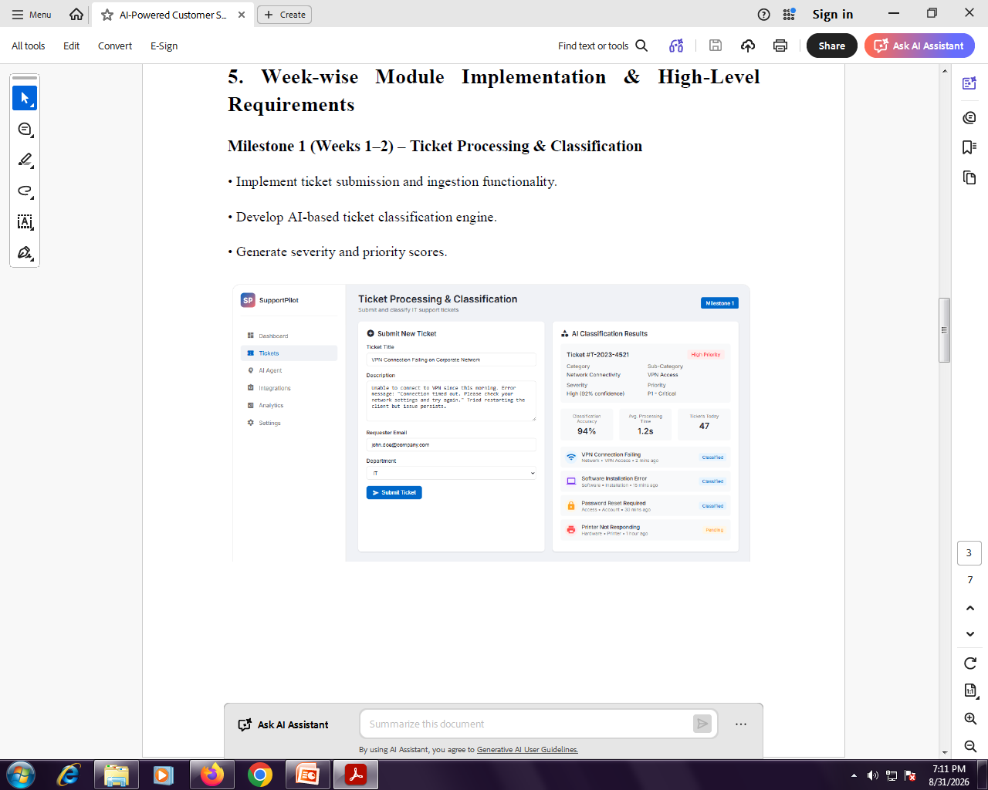

Slide 56
